Slide 1
The Coptic Letters

Slide 2
1.The Vowels
A
E
Y
O
I
W

Slide 3
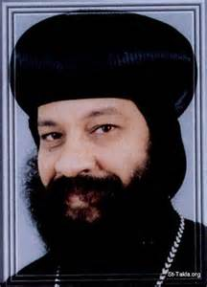
A
Name:- Alpha
Sound:- A
Word in Coptic:- abba
In English:- Avva
Meaning:- Father

Slide 4
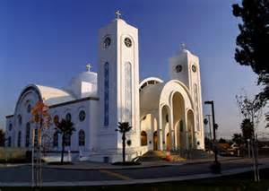
E
Name:- E
Sound:- E
Word in Coptic:- ek`klycia
In English:- ek`klycia
Meaning:- Church

Slide 5
Y
Name:- Eeta
Sound:- EE
Word in Coptic:- `smyn
In English:- Eshmyn
Meaning:- Eight

Slide 6
O
Name:- o
Sound:- O
Word in Coptic:- ouai
In English:- Ouai
Meaning:- One

Slide 7
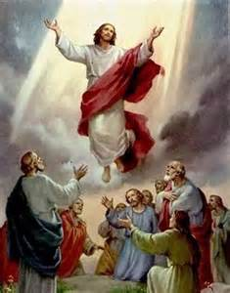
I
Name:- Yota
Sound:- I
Word in Coptic:- `e`pswi
In English:- Eepshoui
Meaning:- Ascend

Slide 8
w
Name:- Oo
Sound:- OU
Word in Coptic:- wnq
In English:- Ounkh
Meaning:- Life

Slide 9
Now Read by yourself
abba

Slide 10
ek`klyca

Slide 11
`smyn

Slide 12
ouai

Slide 13
`e`pswi

Slide 14
wnq

Slide 15
2. letters like the English letters
B
C
M
N
K
T
Z

Slide 16
B
Name:- Vita
Sound:- Always like a B
Word in Coptic:- ouab
In English:- ouab
Meaning:- Holy

Slide 17
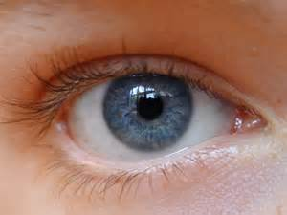
B
Name:- Vita
Sound:- V when it comes after it a vowel
Word in Coptic:- bal
In English:- val
Meaning:- eye

Slide 18
C
Name:- Seema
Sound:- s
Word in Coptic:- `cnau
In English:- ecnav
Meaning:- two

Slide 19
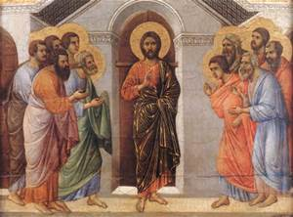
M
Name:- Mey
Sound:- M
Word in Coptic:- ma;ytyc
In English:- mathytyc
Meaning:- Disciples

Slide 20
n
Name:- Ney
Sound:- N
Word in Coptic:- nah]
In English:- Nahty
Meaning:- Faith

Slide 21
k
Name:- Kabba
Sound:- K
Word in Coptic:- Kahi
In English:- kahi
Meaning:- Earth

Slide 22
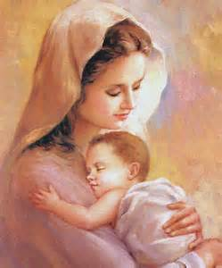
T
Name:- Tav
Sound:- T
Word in Coptic:- tamau
In English:- tamav
Meaning:- My mother

Slide 23
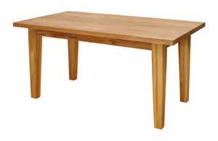
z
Name:- Zeeta
Sound:- z
Word in Coptic:- `trapeza
In English:- etrapeza
Meaning:- table

Slide 24
Now Read by yourself
ouab

Slide 25
bal

Slide 26
`cnau

Slide 27
ma;ytyc

Slide 28
nah]

Slide 29
Kahi

Slide 30
tamau

Slide 31
`trapeza

Slide 32
3- Letters look like English but different pronunciations
R
Y
<

Slide 33
r
Name:- Roo
Sound:- R
Word in Coptic:- ran
In English:- ran
Meaning:- Name

Slide 34
y
Name:- Eeta
Sound:- EE
Word in Coptic:- `smyn
In English:- Eshmyn
Meaning:- Eight

Slide 35
<
Name:- key
Sound:- K normally in the coptic letters
Word in Coptic:- ,aki
In English:- kaki
Meaning:- Darkness

Slide 36
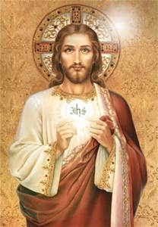
<
Name:- key
Sound:- Kh in the Greek words
Word in Coptic:- `` ,rictoc
In English:- ekhristos
Meaning:- Christ

Slide 37
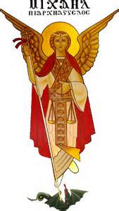
<
Name:- key
Sound:- sh if one of the E family (e y i u) comes after it
Word in Coptic:- ar,yaggeloc
In English:- Arsheeangelos
Meaning:- Archangel

Slide 38
Now read by yourself
ran

Slide 39
`smyn

Slide 40
,aki

Slide 41
`` ,rictoc

Slide 42
ar,yaggeloc

Slide 43
4- Letters look like Math or Science letters
:
D
L
G

Slide 44
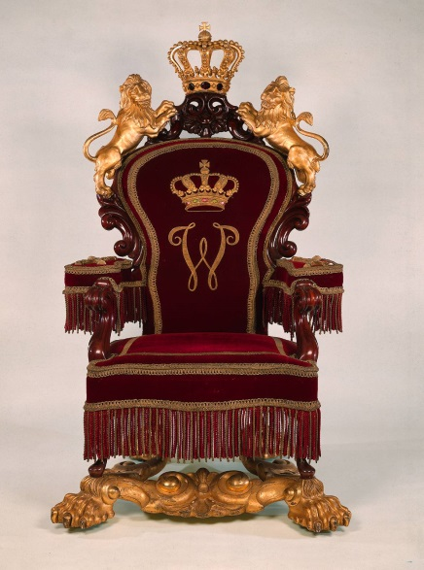
;
Name:- Theeta
Sound:- Normally sounds like th
Word in Coptic:- `:ronoc
In English:- ethronos
Meaning:- Throne

Slide 45
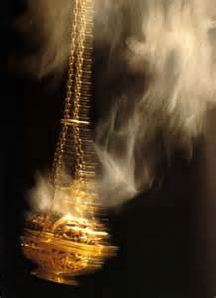
;
Name:- Theeta
Sound:- If one of these letters (cts) comes before it it will sounds like t.
Word in Coptic:- `c;oi
In English:- estoi
Meaning:- Aroma/smell

Slide 46
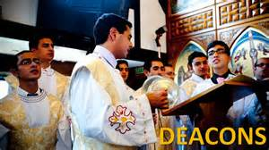
D
Name:- Delta
Sound:- normally sounds like a z.
Word in Coptic:- Diakwn
In English:- zeacoun
Meaning:- deacon

Slide 47
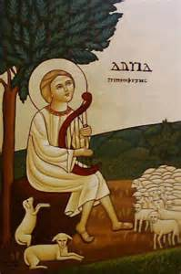
D
Name:- Delta
Sound:- sounds like D only with names.
Word in Coptic:- Dauid
In English:- Daveed
Meaning:- David

Slide 48
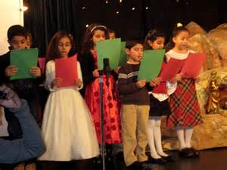
L
Name:- Lolla
Sound:- L
Word in Coptic:- Lali
In English:- Lali
Meaning:- Sing

Slide 49
G
Name:- Ghamma
Sound:- sounds normally like gh
Word in Coptic:- gar
In English:- ghar
Meaning:- For - because

Slide 50
G
Name:- Ghamma
Sound:- If any of the E family comes after it , it will sounds like g.
Word in Coptic:- Agioc
In English:- agios
Meaning:- Holy

Slide 51
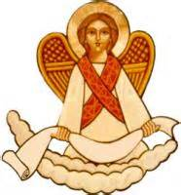
G
Name:- Ghamma
Sound:- If any of these letters(GKX<) comes after it , it will sounds like N
Word in Coptic:- Aggeloc
In English:- angelos
Meaning:- Angel

Slide 52
`:ronoc

Slide 53
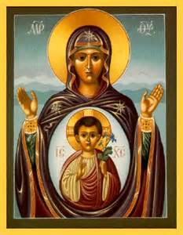
Genne;ic

Slide 54
Diakwn

Slide 55
Dauid

Slide 56
Lali

Slide 57
gar

Slide 58
Agioc

Slide 59
Aggeloc

Slide 60
5-The rest of the coptic letters.
Q
U
X
^
P
"
]

Slide 61
Q
Name:- Khay
Sound:- Kh
Word in Coptic:- wnq
In English:- onkh
Meaning:- Life

Slide 62
U
Name:- Epsolon
Sound:- Always E
Word in Coptic:- kurie
In English:- keriee
Meaning:- Lord

Slide 63
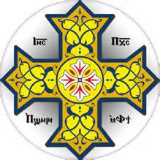
U
Name:- Epsolon
Sound:- sounds like V after A and E
Word in Coptic:- ctauroc
In English:- stavros
Meaning:- cross

Slide 64
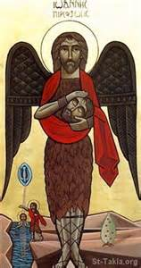
U
Name:- Epsolon
Sound:- The letter Epsolon sounds like O after o
Word in Coptic:- iwannou
In English:- youanno
Meaning:- John

Slide 65
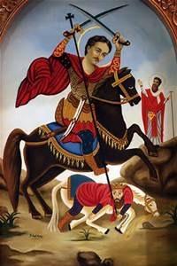
X
Name:- Exsi
Sound:- X
Word in Coptic:- axioc
In English:- aksios
Meaning:- worthy

Slide 66
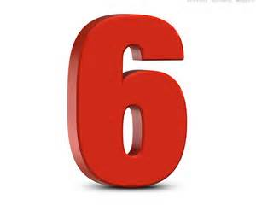
^
Name:- Soo
Sound:- Soo
Word in Coptic:- ^
In English:- soo
Meaning:- Six

Slide 67
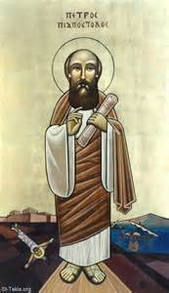
P
Name:- Pee
Sound:- p
Word in Coptic:- petroc
In English:- petros
Meaning:- Peter

Slide 68
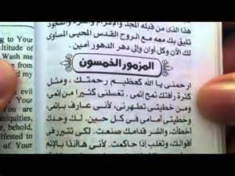
"
Name:- Epsi
Sound:- Eps
Word in Coptic:- "almoc
In English:- epsalmos
Meaning:- Psalm

Slide 69
]
Name:- Tee
Sound:- Ti
Word in Coptic:- †`wou
In English:- teeoou
Meaning:- Glorify

Slide 70
wnq

Slide 71
kurie

Slide 72
ctauroc

Slide 73
iwannou

Slide 74
axioc

Slide 75
^

Slide 76
petroc

Slide 77
"almoc

Slide 78
†`wou

Slide 79
6-The rest of the coptic letters (continue)
V
F
J
S
[
H

Slide 80
V
Name:- Fi
Sound:- F
Word in Coptic:- `avot
In English:- `afot
Meaning:- Cup

Slide 81
F
Name:- Fai
Sound:- F
Word in Coptic:- fote
In English:- fote
Meaning:- Towel

Slide 82
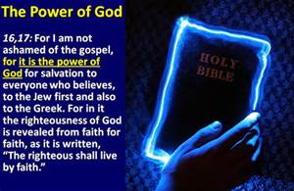
J
Name:- Gunga
Sound:- normally sounds like g
Word in Coptic:- jom
In English:- gom
Meaning:- Power

Slide 83
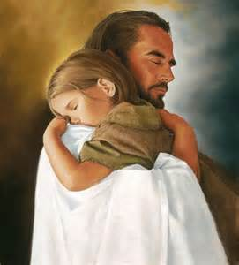
J
Name:- Gunga
Sound:- If any of the E family comes after it will sounds like j
Word in Coptic:- aijemnom]
In English:- aijemnomtee
Meaning:- comforted

Slide 84
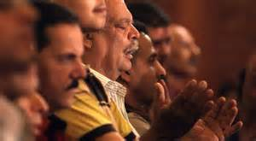
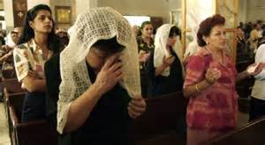
S
Name:- Shai
Sound:- Sh
Word in Coptic:- ``slyl
In English:- Eshleel
Meaning:- Pray

Slide 85
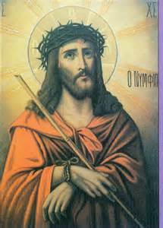
[
Name:- Cheema
Sound:- Ch
Word in Coptic:- pen[oic
In English:- penchois
Meaning:- our Lord

Slide 86
H
Name:- Horry
Sound:- H
Word in Coptic:- `hmot
In English:- ehmot
Meaning:- grace

Slide 87
`avot

Slide 88
fote

Slide 89
jom

Slide 90
aijemnom]

Slide 91
pen[oic

Slide 92
`slyl

Slide 93
`hmot

